Slide 1
Gorgeous places of Slovakia
Marek Kačmár
3.A
GJAR

Slide 2
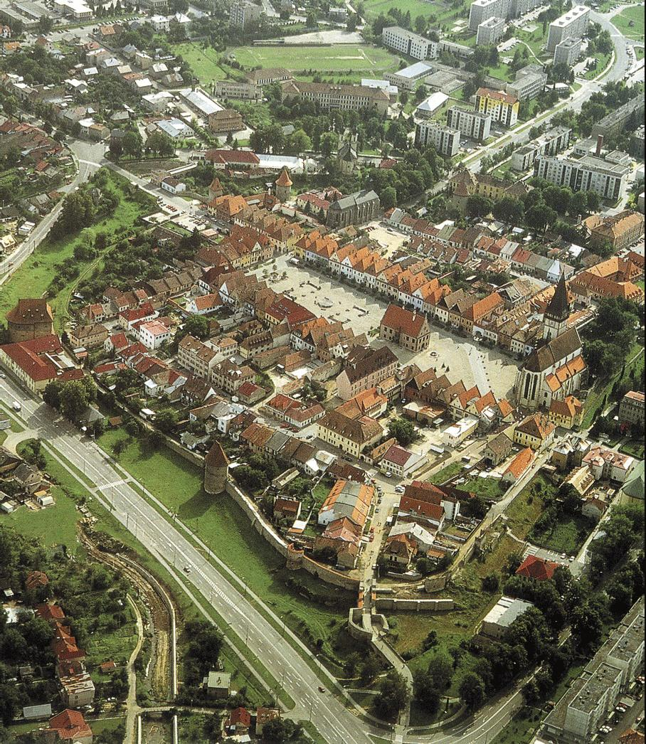
Bardejov
city that writes for over 771-
year history
world-famous spa, beautiful
natural surroundings and
relatively undisturbed
environment
natural center of tourism in
the Prešov region and an
important destination in
Slovakia
Jewish suburb was in 2000
registered on the UNESCO
World Cultural and Natural Heritage

Slide 3
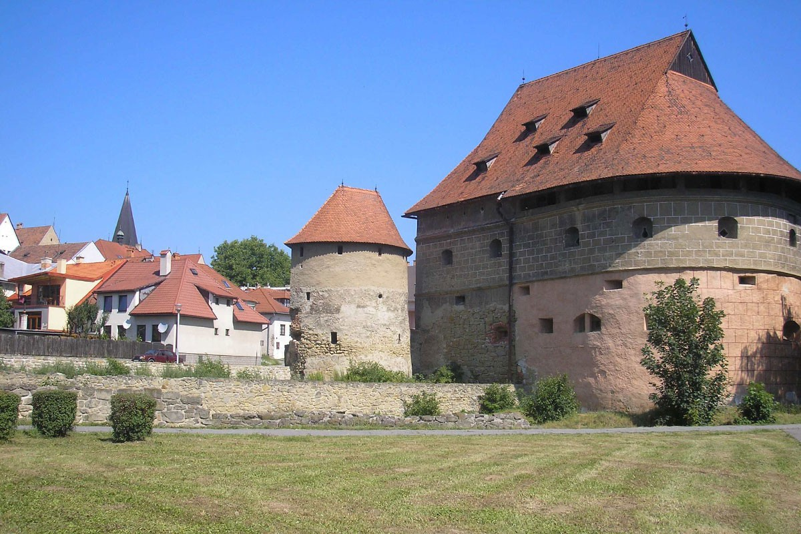

Slide 4
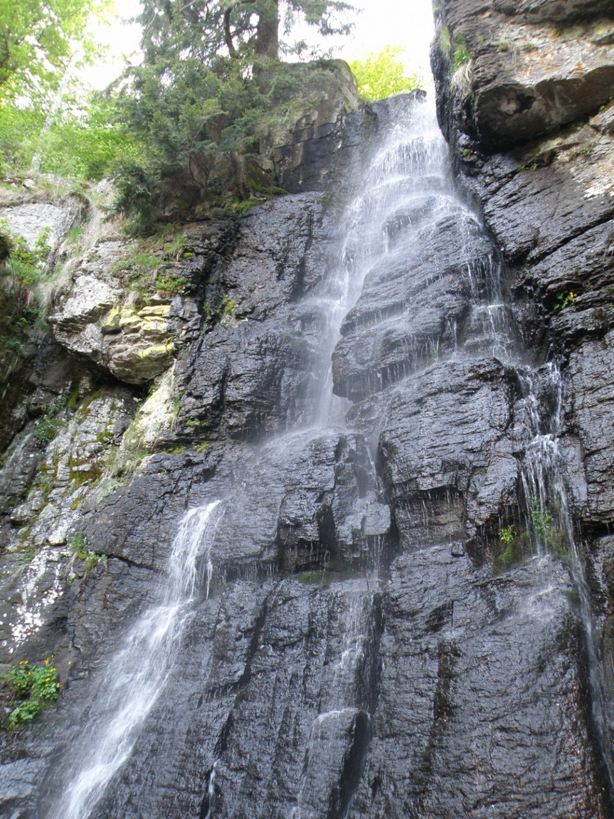
Waterfall Bystré
located in a cadastral area of
the city Hriňová inside of the
Slovak Ore Mountains
height of waterfall is 23
meters
registered as a protected
natural monument since 1982

Slide 5
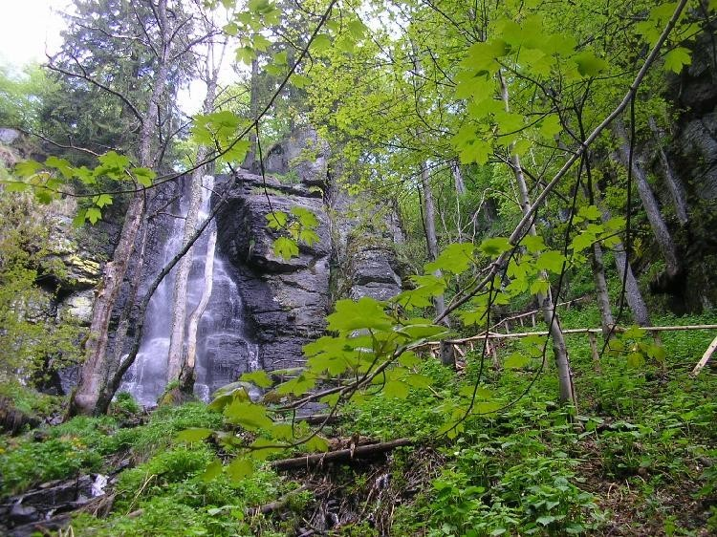
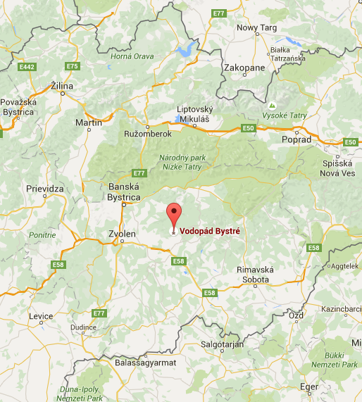

Slide 6
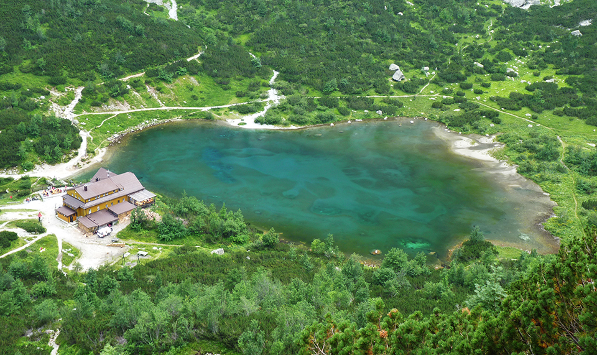
Green Tarn
moraine tarn inside the Green Tarn valley
1 545 meters above ground level, it has extent of 1,78 hectares and is 4,5 meters deep
the green color of the tarn has interested many gold diggers and hunters
romantic fables
about a gemstone
greenish color from
springs

Slide 7
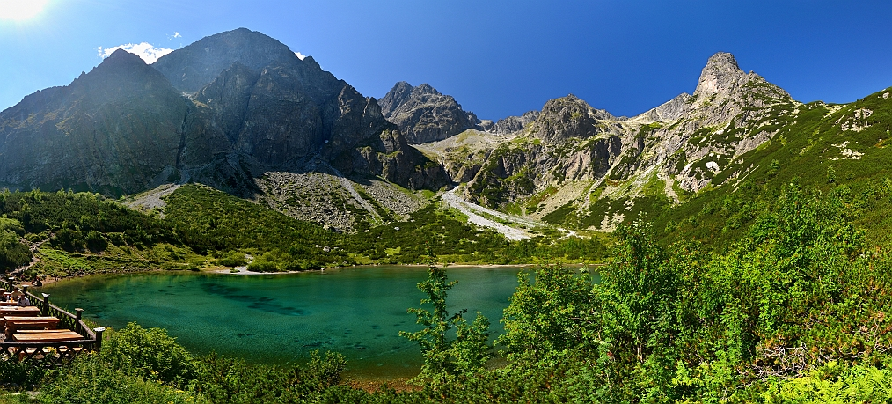

Slide 8
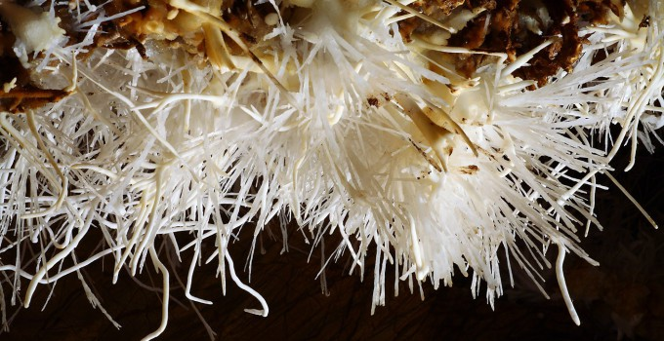
Ochtinská Aragonite Cave
unique aragonite cave situated in southern Slovakia
it is famous for its rare aragonite filling
Milky Way Hall is the main attraction of the cave
white branches and clusters of aragonite
discovered by Martin Cangár and Jiri Prosek in 1954 and opened to the public in 1972
included in the UNESCO World Heritage list as
component of Caves of
Aggtelek Karst and Slovak
Karst

Slide 9
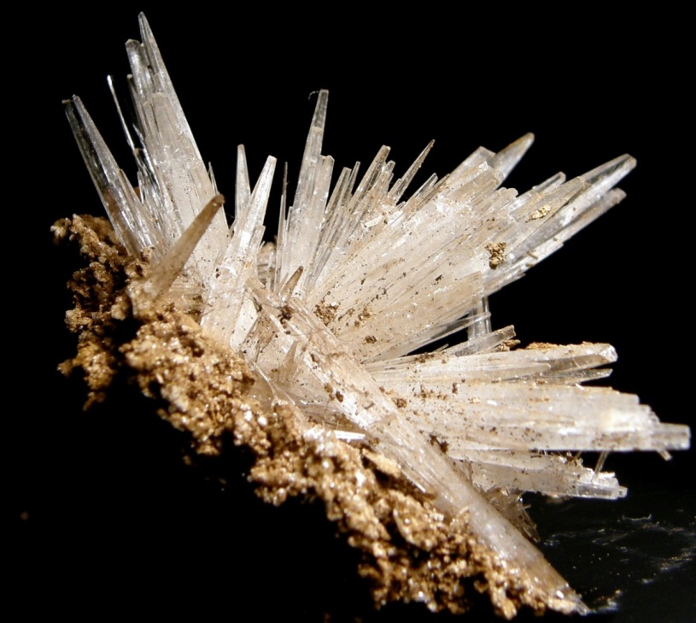
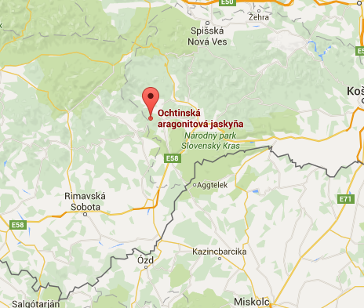

Slide 10
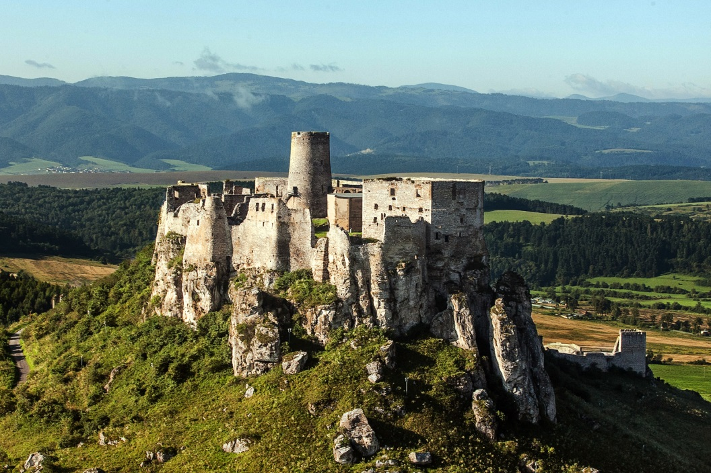
Spiš Castle
one of the largest castle sites in Central Europe
situated above the town of Spišské Podhradie and the village of Žehra, in the region known as Spiš
included in the UNESCO list of World Heritage Sites in 1993
built in the 12th century on the site of an earlier castle
political, administrative, economic and cultural centre of the Kingdom of Hungary
1780, the castle burned down
after the fire, the castle was
no longer occupied

Slide 11
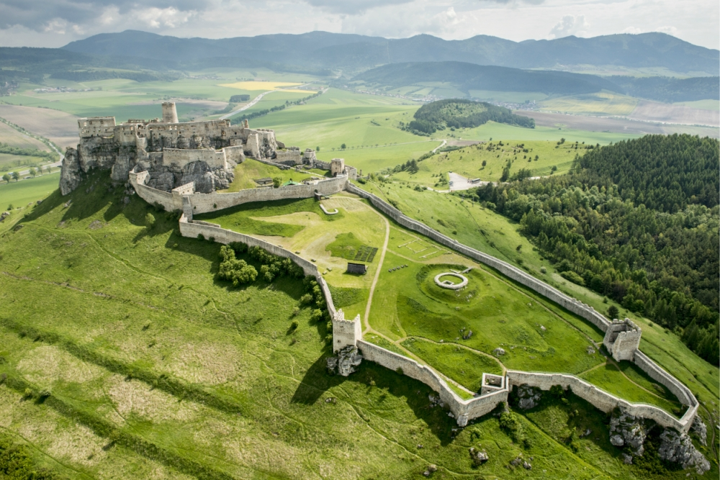
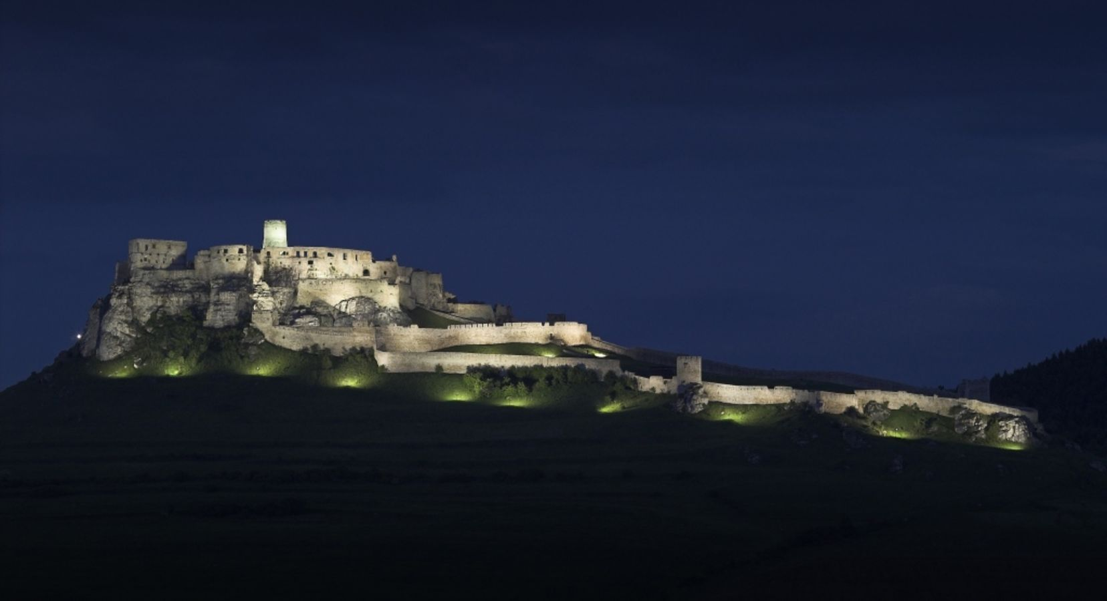

Slide 12
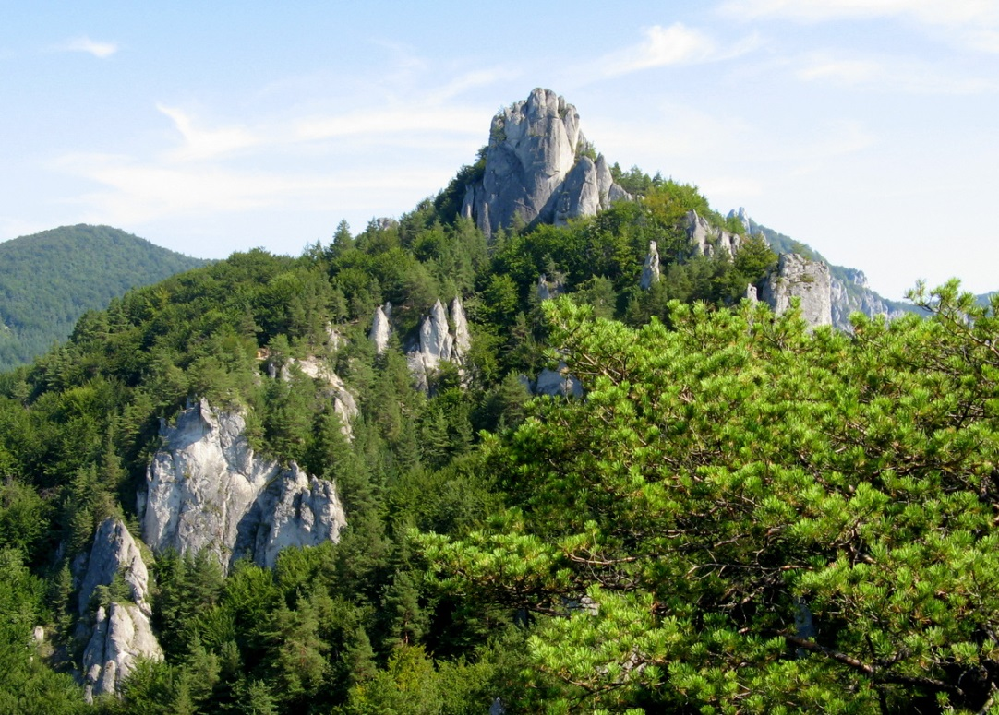
Súľov Rocks
geomorphological
subassembly of the
Súľov Mountains,
characteristic by significnant ragged relief
10 kilometres south of the city Bytča and west of Súľov Mountains
popular by tourists
nature trail leads all over the area which was built in 1975
7,5 kilometres long and it has 16 stops which are supplemented by 17 information boards

Slide 13
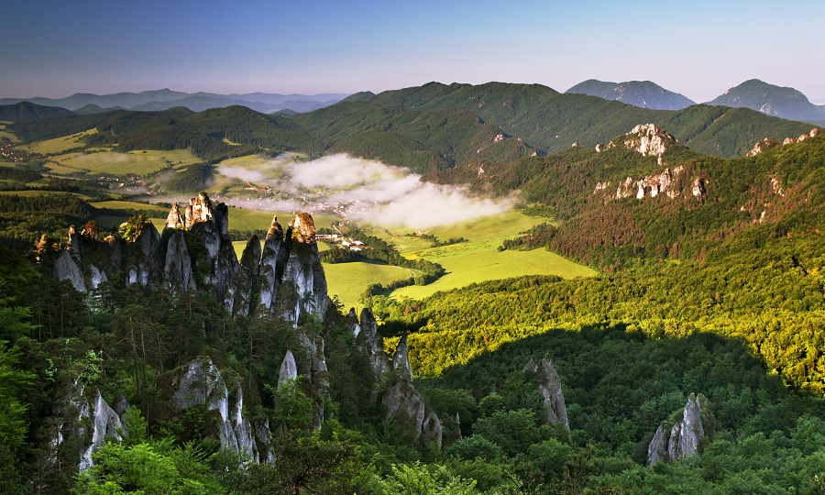

Slide 14
Sources
http://www.bardejov.sk/bardejov/o-meste
http://www.bardejov.sk/images/stories/bj-leteck.jpg
http://www.whatdohere.com/data/event_photo/big/big_photo51.jpg
http://foto.hory.sk/pictures/show_Vodopad%20Bystre%20(2).jpg
www.wikipedia.com
http://i712.photobucket.com/albums/ww128/Aastra28/Astra28/Jaskinie/Ochtinska/Ochtinska_12.jpg
http://www.extraslovensko.sk/sites/default/files/styles/full_size/public/images_photogallery_hotel/ochtin.jpg?itok=YKXrKLWC
https://a-static.projektn.sk/2015/03/spissky-hrad-15-of-30.jpg.jpg
http://sacr3-files.s3-website-eu-west-1.amazonaws.com/_processed_/csm_Spi%25C5%25A1sk%25C3%25BD%2520hrad_Roman%2520Malega_e955fa09f9.jpg
https://www.richardhlavna.sk/wp-content/uploads/2014/05/letecke_009.jpg
https://upload.wikimedia.org/wikipedia/commons/d/d1/Sulovskie_skaly_01.JPG
http://images.newgo.cz/39/21/39219.jpg

Slide 15
Thank you for your attention

